Slide 1
3D Game Programming Proposal
Game Name: runny hero
Team Members: 劉承順

Slide 2
Introduction
I want to make a 3D game by using Ogre 3D.
Differs form 2D games, 3D games have advantage on screen, but disadvantage about control. So I decide to do a game, the character player controls automatically moves and attack monsters. On the other hand, player can cast some skills.
The Reward System, such as level up system, inventory system, is the motivation to the player to play this game longer.

Slide 3
Game Story
An adventurer who comes to a mystic island, he is granted the power of magic and sword. He climbs mountain, pass forest, go through a lake, an encounter monsters in a plain. He battles to enemies, gather treasures and weapons, in order to get stronger and stronger. To travel and discover the world.

Slide 4
Game Type
Action-adventure game
video games that combine core elements from the action and adventure genres.

Slide 5
Game Design Document
6.1 Gameplay
The player controls a humon-like avatar. The avatar runs or attack automatically, but it can also be controlled by player. Player can decides moving direction and casts spells by clicking hotkeys.
6.2 User Interface, Game Controls
6.2.1 player Perspective (camera)
Player can switchs perspectives as first person or second person, i.e. the sight of the avatar and the sight from behind of the avatar respectively.
6.2.2 keyboard and mouse control
click 'a' to change move direction to left, click 'b' to change move direction to right.

Slide 6
Technical Design Document
8.1 System Characteristics
It is a 3D game and even moves the camera quickly and continuously. I would pursue good battle screen, because it is the main scene the player would see.
8.2 System Architecture
8.3 Design Method and Standards
build terrain->build barrier objects ->create character ->design actions and key control ->Number tuning ->sound and FX ->debug

Slide 7
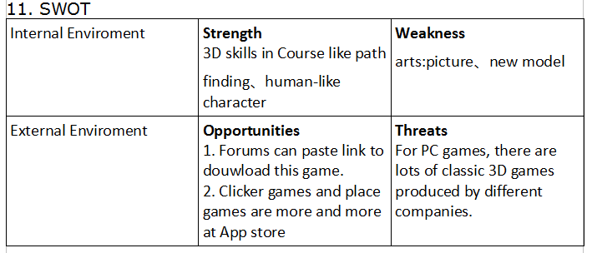
SWOT

Slide 8
Conclusion
12.1 Game Features
The avatar runs and battles automatically, providing easy control as a 3D game. Players can enjoy the feelings of catching the wind.
12.2 Game play
Players control the direction of avatar, search the terrain, and fight monsters to level up.
12.3 Game product positioning
If I finish this game, maybe I will upload it to some forums for others to download for free.
12.4 Target player
Players who like to fight monsters, feeling the excitement from leveling up . And Players who like 3D game screens.

